Slide 1
Heat Transfers, lecture 2, still Lesson 2: the Maxwell-Boltzmann distribution
Teacher: Paul Briard

Slide 2
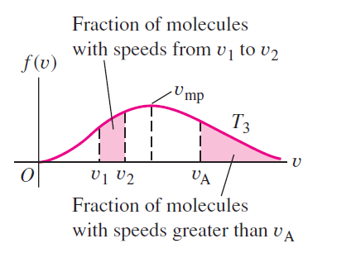
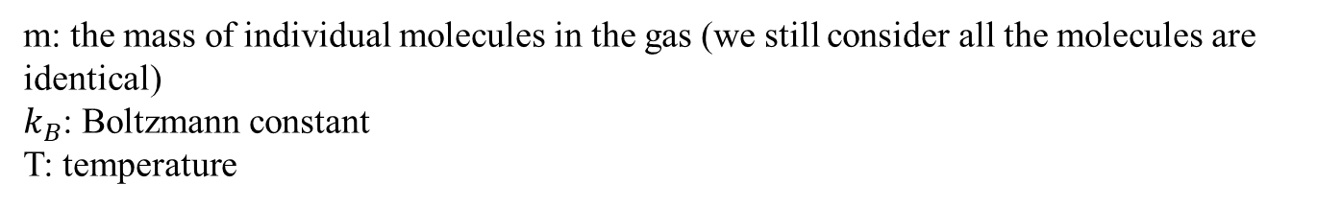
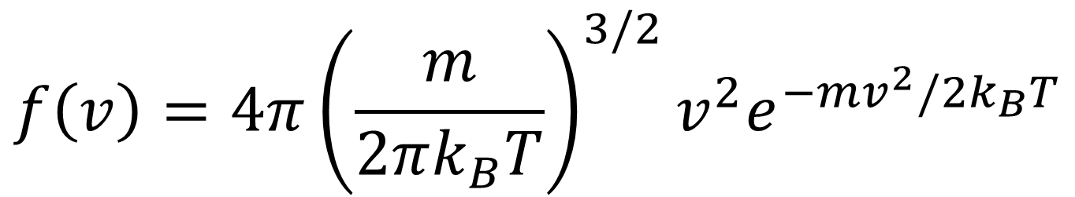
The Maxwell-Boltzmann distribution law
$$f\left(v\right)=4π{\left(\frac{m}{2πk_{B}T}\right)}^{3/2}v^{2}e^{−mv^{2}/2k_{B}T}$$
Because of this term, $f(v)$ is not a Gaussian function
m: the mass of individual molecules in the gas (we still consider all the molecules are identical)
$k_{B}$: Boltzmann constant
T: temperature
In a graph, the distribution is not so complicated:
Well, it’s a bit complicated, you don’t have to remember

Slide 3

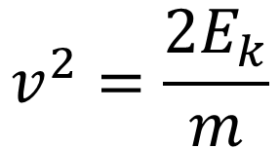
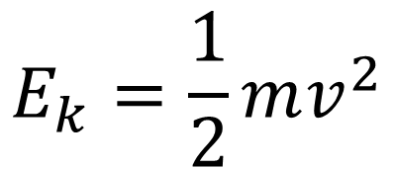
The Maxwell-Boltzmann distribution law
$$f\left(v\right)=4π{\left(\frac{m}{2πk_{B}T}\right)}^{3/2}v^{2}e^{−mv^{2}/2k_{B}T}$$
The kinetic energy of a molecule of mass $m$ and velocity $v$ is:
$$E_{k}=\frac{1}{2}mv^{2}$$
$$v^{2}=\frac{2E_{k}}{m}$$
There is also a distribution for the kinetic energy:
$$f\left(E_{k}\right)$$
(I don’t give you here, you can find it easily if you wish)

Slide 4


The Maxwell-Boltzmann distribution law
The number of molecules which the speed in the range between $v_{1}$ and $v_{2}$is:
$$N_{\left[v_{1},v_{2}\right]}=N\int_{v_{1}}^{v_{2}}{f\left(v\right)dv}$$
Area under the curve $f(v)$

Slide 5


The Maxwell-Boltzmann distribution law
The number of molecules which the speed is greater than a speed $v_{A}$ is:
$$N_{v>v_{A}}=N\int_{v_{A}}^{∞}{f\left(v\right)dv}$$
Area under the curve $f(v)$

Slide 6
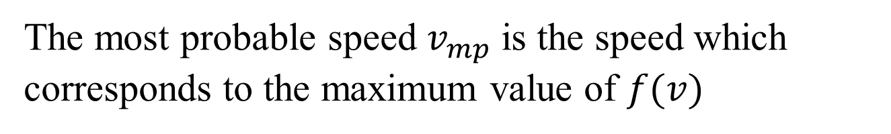
The most probable speed
The most probable speed $v_{mp}$is the speed which corresponds to the maximum value of $f(v)$

Slide 7
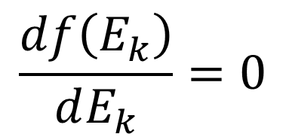


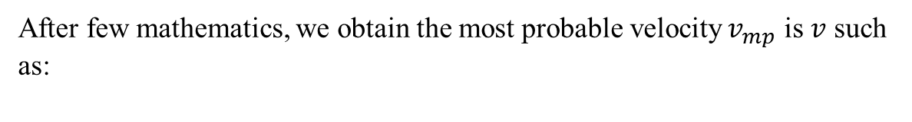
The most probable speed
The most probable velocity corresponds to a maximum value of $f\left(E_{k}\right)$, i.e.
$$\frac{df\left(E_{k}\right)}{dE_{k}}=0$$
After few mathematics, we obtain the most probable velocity$v_{mp}$ is $v$ such as:
$$E_{k}=k_{B}T$$
$$v_{mp}=\sqrt{\frac{2k_{B}T}{m}}$$
Full demonstration, not given here but is not difficult.

Slide 8
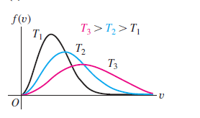
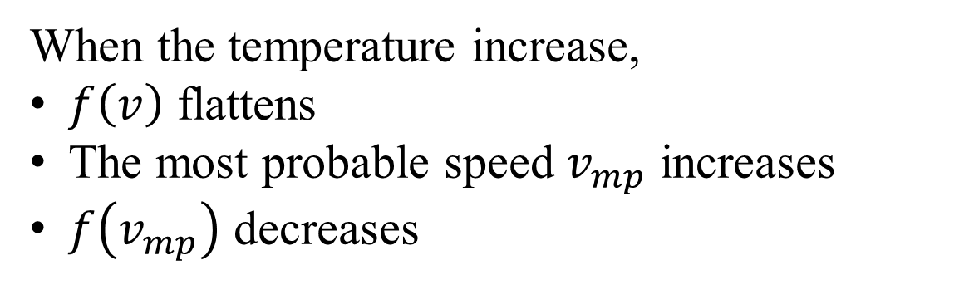



Influence of the temperature
$$v_{mp,1}$$
$$v_{mp,2}$$
$$v_{mp,3}$$
When the temperature increase,
$f\left(v\right)$ flattens
The most probable speed $v_{mp}$ increases
$f\left(v_{mp}\right)$ decreases

Slide 9
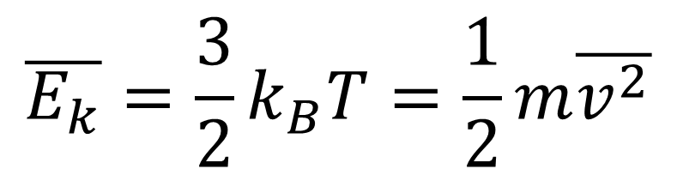
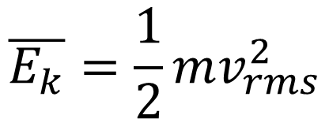
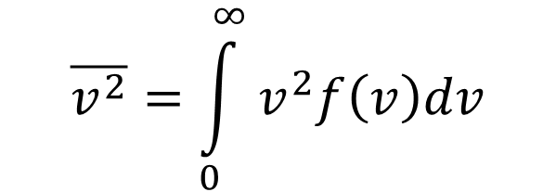
The root mean square (RMS) velocity
We have seen last lesson the average kinetic energy is:
$$\overline{E_{k}}=\frac{3}{2}k_{B}T=\frac{1}{2}m\overline{v^{2}}$$
From the Maxwell-Boltzmann distribution, after few mathematics, we should have obtained the same result.
$$\overline{v^{2}}=\int_{0}^{∞}{v^{2}f\left(v\right)dv}$$
$$\overline{E_{k}}=\frac{1}{2}mv_{rms}^{2}$$

Slide 10
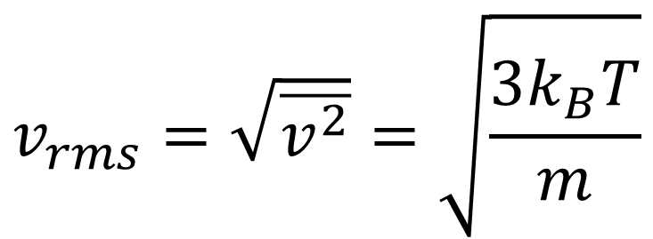
The root mean square (RMS) velocity
We have seen last lesson the average translational kinetic energy is:
$$\overline{E_{k}}=\frac{3}{2}k_{B}T=\frac{1}{2}m\overline{v^{2}}$$
From the Maxwell-Boltzmann distribution, after few mathematics, we should have obtained the same result.
The rms velocity is the velocity which corresponds to the average kinetic energy:
$$v_{rms}=\sqrt{\overline{v^{2}}}=\sqrt{\frac{3k_{B}T}{m}}$$
Important to remember
There is also an average velocity $\overline{v}$ obtained from the MB distribution (but less interesting)
$$\overline{E_{k}}=\frac{1}{2}mv_{rms}^{2}$$

Slide 11
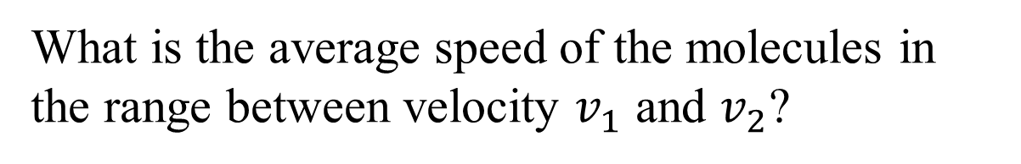
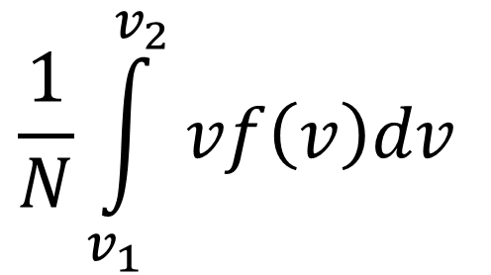
Warning …
What is the average speed of the molecules in the range between velocity $v_{1}$ and $v_{2}$?
$$\frac{1}{N}\int_{v_{1}}^{v_{2}}{vf\left(v\right)dv}$$
Is it
?

Slide 12
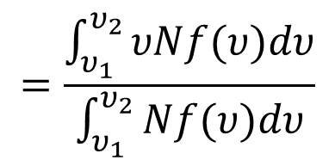
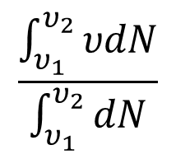
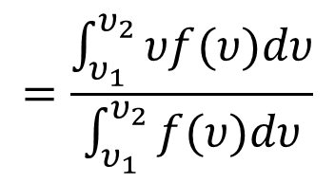
Warning …
What is the average speed of the molecules in the range between velocity $v_{1}$ and $v_{2}$?
$$\frac{1}{N}\int_{v_{1}}^{v_{2}}{vf\left(v\right)dv}$$
Is it
?
The average velocity of the molecules in the range between $v_{1}$ and $v_{2}$ is:
$$\frac{\int_{υ_{1}}^{υ_{2}}{υdN}}{\int_{υ_{1}}^{υ_{2}}{dN}}$$
$$=\frac{\int_{υ_{1}}^{υ_{2}}{υNf(υ)dυ}}{\int_{υ_{1}}^{υ_{2}}{Nf(υ)dυ}}$$
$$=\frac{\int_{υ_{1}}^{υ_{2}}{υf(υ)dυ}}{\int_{υ_{1}}^{υ_{2}}{f(υ)dυ}}$$

Slide 13

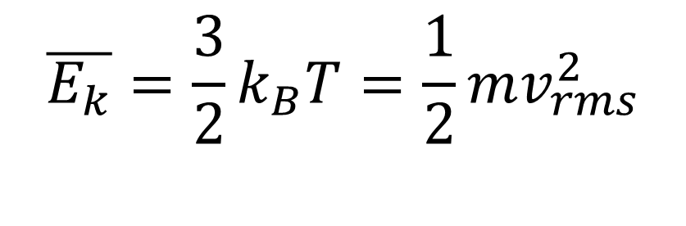
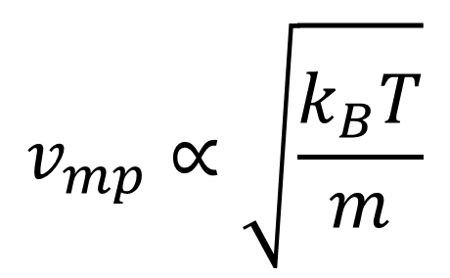
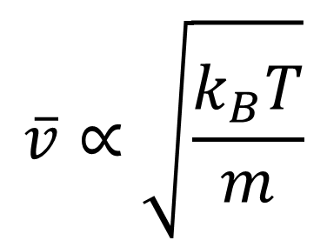
Summary: Characteristics velocities of an ideal gas (important to remember)
Average kinetic energy:
$$\overline{E_{k}}=\frac{3}{2}k_{B}T=\frac{1}{2}mv_{rms}^{2}$$
$$v_{rms}=\sqrt{\overline{v^{2}}}=\sqrt{\frac{3k_{B}T}{m}}$$
About the two other characteristic velocities, you just have to know that, as $v_{rms}$:
$$v_{mp}∝\sqrt{\frac{k_{B}T}{m}}$$
$$\overline{v}∝\sqrt{\frac{k_{B}T}{m}}$$
Most probable velocity
Average velocity

Slide 14
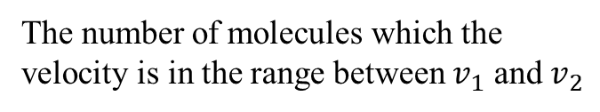
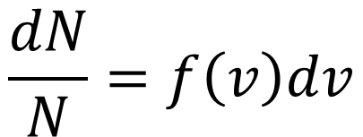
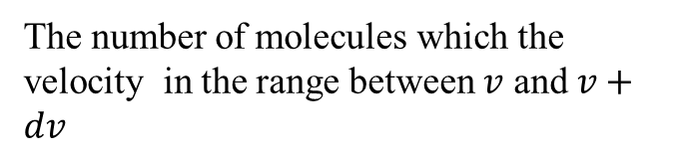


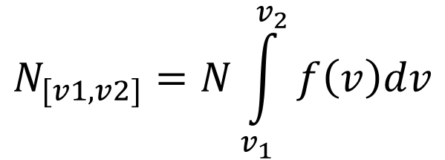
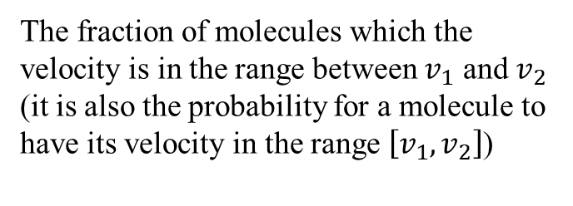
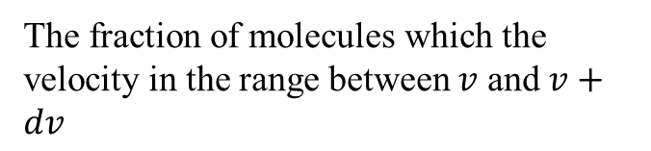
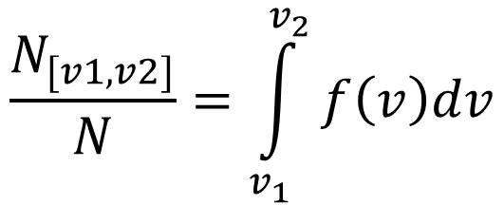
Summary about $f(v)$
$$dN=Nf\left(v\right)dv$$
The number of molecules which the velocity in the range between $v$ and $v+dv$
$$\frac{dN}{N}=f\left(v\right)dv$$
The fraction of molecules which the velocity in the range between $v$ and $v+dv$
$$N_{[v1,v2]}=N\int_{v_{1}}^{v_{2}}{f\left(v\right)dv}$$
The number of molecules which the velocity is in the range between $v_{1}$ and $v_{2}$
$$\frac{N_{[v1,v2]}}{N}=\int_{v_{1}}^{v_{2}}{f\left(v\right)dv}$$
The fraction of molecules which the velocity is in the range between $v_{1}$ and $v_{2}$ (it is also the probability for a molecule to have its velocity in the range $\left[v_{1},v_{2}\right]$)

Slide 15
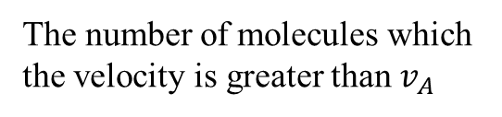
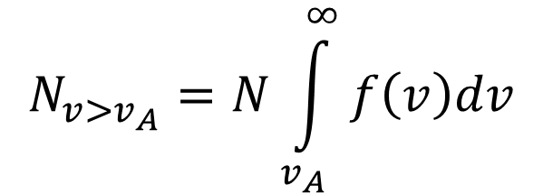
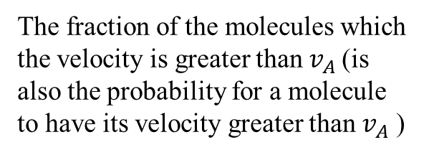
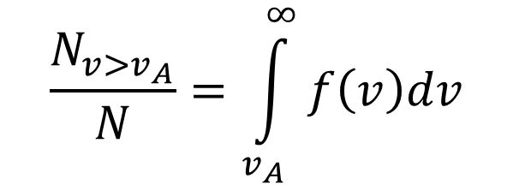
Summary about $f(v)$
$$N_{v>v_{A}}=N\int_{v_{A}}^{∞}{f\left(v\right)dv}$$
The number of molecules which the velocity is greater than $v_{A}$
$$\frac{N_{v>v_{A}}}{N}=\int_{v_{A}}^{∞}{f\left(v\right)dv}$$
The fraction of the molecules which the velocity is greater than $v_{A}$(is also the probability for a molecule to have its velocity greater than $v_{A}$ )
To remember them easily, the best way it is to understand them, the issue is that understanding these concepts could be quite difficult, if you are not used to probabilities !

Slide 16
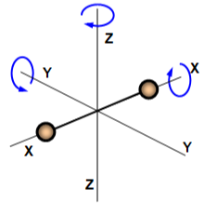
Heat transfers, Lesson 3: Degrees of freedom and internal energy of an ideal gas
Teacher: Paul Briard
Wechat: Paulbg123
https://byjus.com/physics/law-equipartition-energy/

Slide 17



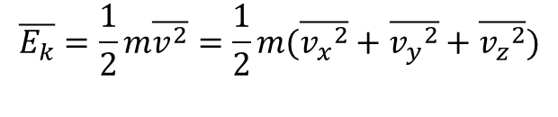
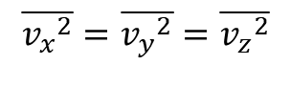
Introduction: the equipartition of energy
In the previous lessons, which describe the ideal gas, we had already a small approach of the equipartition !
$$v^{2}={v_{x}}^{2}+{v_{y}}^{2}+{v_{z}}^{2}$$
$$\overline{v^{2}}=\overline{{v_{x}}^{2}}+\overline{{v_{y}}^{2}}+\overline{{v_{z}}^{2}}$$
Velocity of the molecules of the gas and its components
Average of the square of the velocity
The average translational kinetic energy is:
$$\overline{E_{k}}=\frac{1}{2}m\overline{v^{2}}=\frac{1}{2}m(\overline{{v_{x}}^{2}}+\overline{{v_{y}}^{2}}+\overline{{v_{z}}^{2}})$$
There was no difference between the x-,y- and z-directions
$$\overline{{v_{x}}^{2}}=\overline{{v_{y}}^{2}}=\overline{{v_{z}}^{2}}$$
$$\overline{E_{k}}=\frac{3}{2}m\overline{{v_{x}}^{2}}=\frac{3}{2}m\overline{{v_{y}}^{2}}=\frac{3}{2}m\overline{{v_{z}}^{2}}$$
Each direction contribute to one third of the kinetic energy, each contribution are the same !

Slide 18
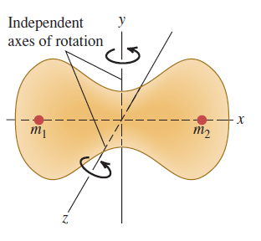
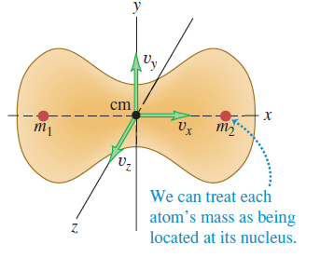


Introduction
Average translational kinetic energy of a molecule (point-like):
$$\overline{E_{k}}=\frac{3}{2}k_{B}T$$
$$\frac{1}{2}m\overline{{v_{x}}^{2}}=\frac{1}{2}m\overline{{v_{y}}^{2}}=\frac{1}{2}m\overline{{v_{z}}^{2}}=\frac{1}{2}k_{B}T$$
But a molecule is not strictly a point-like
Forms of motion of the molecules (here example of a diatomic molecule):
Translational
Rotational
cm: “center of mass”

Slide 19

Introduction
Average translational kinetic energy of a molecule (point-like):
$$E_{k,av}=\frac{3}{2}k_{B}T$$
$$\frac{1}{2}m\overline{{v_{x}}^{2}}=\frac{1}{2}m\overline{{v_{y}}^{2}}=\frac{1}{2}m\overline{{v_{z}}^{2}}=\frac{1}{2}k_{B}T$$
But a molecule is not strictly a point-like
Forms of motion of the molecules:
Translational
Rotational
Forms of energy of the molecules associated with the motion:
Translational
kinetic energy
Rotational
kinetic energy
We must to use the concept of degrees of freedom

Slide 20

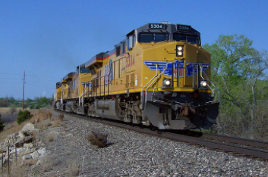



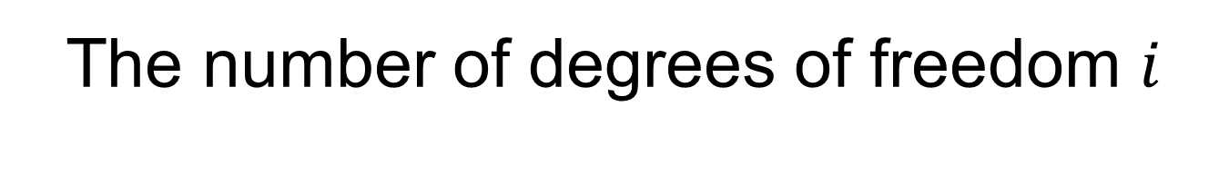
The number of degrees of freedom $i$
The number of degrees of freedom is the number of velocity components needed to describe the motion
1. Translational motion
$$i=3$$
3D free motion (example: aircraft)
Free motion on a plane surface
(example: ship on the sea)
$$i=2$$
Free motion on a line
(example: locomotive)
$$i=1$$

Slide 21



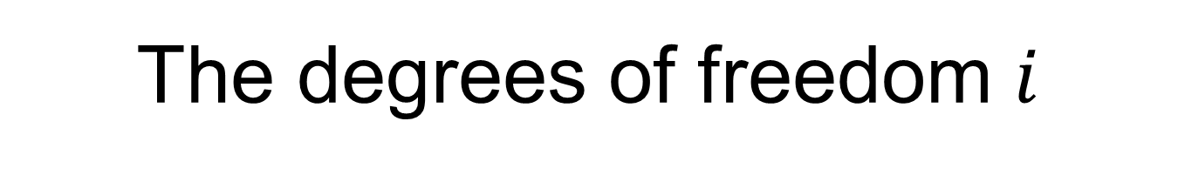


The degrees of freedom $i$
2. Number of degrees of freedom of a rigid axially symmetric rod
It has two perpendicular axis of rotations perpendicular to the axis of the rod (the axis of axially symmetry is not included as an axis of rotation)
Degrees of freedom for translational motion:
$$i_{tr}=3$$
Degrees of freedom for rotational motion:
$$i_{rot}=2$$
Degree of freedom of a rigid axially symmetric rod:
$$i=i_{tr}+i_{rot}=3+2=5$$

Slide 22





The degrees of freedom $i$
3. Degree of freedom of a rigid irregular object, without axis of rotational symmetry (example: aircraft)
Degree of freedom for translational motion:
$$i_{tr}=3$$
Degree of freedom for rotational motion:
$$i_{rot}=3$$
Number of degrees of freedom $i=i_{tr}+i_{rot}=3+3=6$

Slide 23
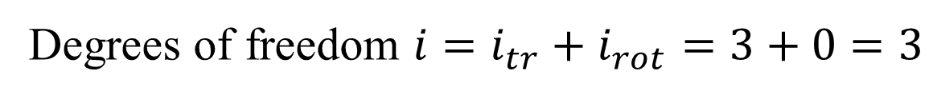


The degrees of freedom $i$
4. Degree of freedom of a rigid sphere
Degree of freedom for translational motion:
$$i_{tr}=3$$
Degree of freedom for rotational motion:
$$i_{rot}=0$$
Degrees of freedom $i=i_{tr}+i_{rot}=3+0=3$
This situation is similar with the degree of freedom of point-like molecule, because of the particular geometry of the sphere !

Slide 24
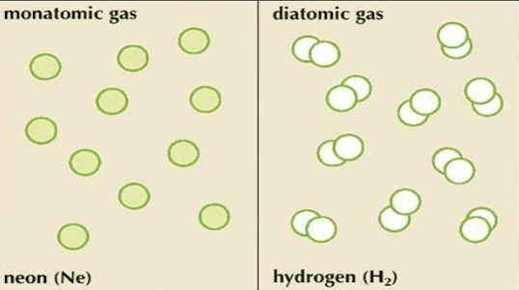
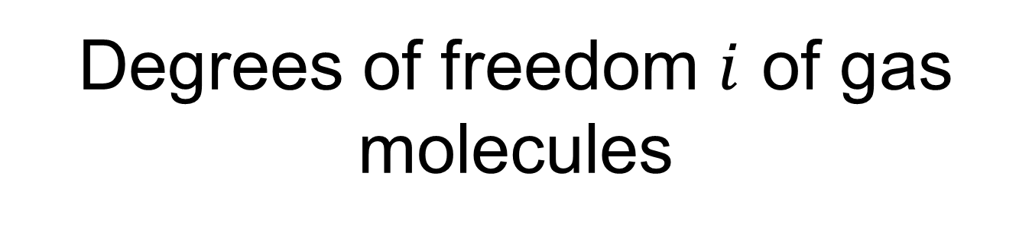
Degrees of freedom $i$ of gas molecules
Monoatomic gas:
i＝3
examples：He、Ne、Ar、Kr…… (situation similar with the point-like case and the sphere)
i＝5
examples：H₂、O₂…… (situation similar with the rigid axially symmetric rod )
Diatomic molecules:
http://kids.britannica.com/comptons/art-53825/Molecules-of-neon-a-monatomic-gas-have-only-one-atom

Slide 25
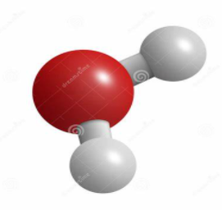
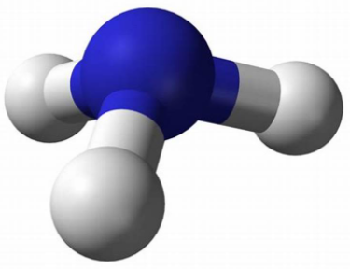





Degrees of freedom $i$ of gas molecules
Molecules with more than two atoms (excepted those with linear arrangement such as CO₂ $:i=5$):
i＝6
examples：H₂O、NH₃……(situation similar with the aircraft)
$H_{2}O$ molecule: $i=6$
$NH_{3}$ molecule: $i=6$
https://www.dreamstime.com/royalty-free-stock-images-water-molecule-image15345519
http://newenergyandfuel.com/http:/newenergyandfuel/com/2010/02/16/can-ammonia-aka-nh3-be-a-fuel/
Axis of rotational symmetry
$CO_{2}$ molecule: $i=5$

Slide 26







Theorem of equipartition
Because for the ideal gas molecules in the equilibrium state, according to statistical assumptions, due to the extremely frequent collision between molecules, the probability of the molecule moving is equal in all directions
$$\frac{1}{2}m\overline{v_{x}^{2}}=\frac{1}{2}m\overline{v_{y}^{2}}=\frac{1}{2}m\overline{v_{z}^{2}}$$
For a molecule such as $i=3$, each degree of freedom correspond to one direction of translational motion associated with one third of the average kinetic energy:
The average kinetic energy ${\overline{E}}_{k}$ of a point-like molecule (or mass-point molecule) can be decomposed as follows (${\overline{E}}_{k,tr}$ is the translational kinetic energy, there is no rotational motion):
$${\overline{E}}_{k}={\overline{E}}_{k,tr}=\frac{3}{2}k_{B}T=\frac{1}{2}m\overline{v^{2}}$$
$$\frac{1}{2}m\overline{v^{2}}=\frac{1}{2}m\overline{v_{x}^{2}}+\frac{1}{2}m\overline{v_{y}^{2}}+\frac{1}{2}m\overline{v_{z}^{2}}=\frac{3}{2}k_{B}T$$
$$\frac{1}{2}k_{B}T$$
$$\frac{1}{2}k_{B}T$$
$$\frac{1}{2}k_{B}T$$

Slide 27





Theorem of equipartition
$$\frac{1}{2}m{v_{av}}^{2}=\frac{1}{2}m\overline{v_{x}^{2}}+\frac{1}{2}m\overline{v_{y}^{2}}+\frac{1}{2}m\overline{v_{z}^{2}}=\frac{3}{2}k_{B}T$$
$$\frac{1}{2}k_{B}T$$
$$\frac{1}{2}k_{B}T$$
$$\frac{1}{2}k_{B}T$$
$$\frac{1}{2}k_{B}T$$
The average kinetic energy of each degree of freedom of the molecule is
Theorem of equipartition:
Energy is equally divided by degrees of freedom

Slide 28


Theorem of equipartition
If a rigid gas molecule has “$i_{tr}$” translational degrees of freedom and “$i_{rot}$” rotational degrees of freedom,
The average total kinetic energy (translational + rotational kinetic energy) of each gas molecule is
$$\frac{i}{2}k_{B}T=\frac{1}{2}(i_{tr}+i_{rot})k_{B}T$$

Slide 29





Example: average translational and rotational kinetic energy of a diatomic molecule of ideal gas
$$i=i_{tr}+i_{rot}=3+2=5$$
The total (translational and rotational ) kinetic energy is:
$$\frac{i}{2}k_{B}T=\frac{5}{2}k_{B}T$$
Each degree of freedom has corresponding energy
$$\frac{1}{2}k_{B}T$$
The average translational kinetic energy of the diatomic molecule is (3 degrees of freedom of translation)
$$\frac{3}{2}k_{B}T$$
The average rotational kinetic energy of the diatomic molecule is (2 degrees of freedom of rotation)
$$\frac{2}{2}k_{B}T=k_{B}T$$

Slide 30

If there is vibrational motion
Molecules can have vibrational motion around an equilibrium position (as for a SHM but could be much more complicated).
Example of vibrational motion for a di-atomic molecule. The atoms are like two mass points connected by a spring. This vibrational motion is related with Van de Walls forces and could be much more complicated to describe than a simple harmonic motion.

Slide 31

If there is vibrational motion
Molecules can have vibrational motion around an equilibrium position (as for a SHM but could be much more complicated). The number of degrees of freedom is then:
$$i=i_{tr}+i_{rot}+i_{vibr}$$
Degrees of freedom for the translational motion
Degrees of freedom for the rotational motion
Degrees of freedom for the vibrational motion
Example of molecule which have a vibrational motion: $H_{2}$ if the temperature is greater than 600 K

Slide 32







Internal energy
$$\frac{3}{2}k_{B}T$$
Average kinetic energy of a molecule with $i=3$ degrees of freedom
$$\frac{i}{2}k_{B}T$$
Average total kinetic energy of a molecule with $i$ degrees of freedom
$$N\frac{i}{2}k_{B}T$$
Total kinetic energy of N molecules with $i$ degrees of freedom (considering the molecules of the gas are identical, they have the same degrees of freedom)
Which the internal energy of N molecules of an ideal gas:
$$U_{int}=\frac{i}{2}Nk_{B}T$$
Important to remember

Slide 33






Internal energy
The number of molecules in one mole of gas (Avogadro’s number)
$$N_{A}k_{B}=R$$
$$N=N_{A}n$$
(R is the ideal gas constant)
The number of moles of gas
The number of molecules in the gas
We obtain:
$$Nk_{B}=nR$$
$$U_{int}=\frac{i}{2}Nk_{B}T$$
$$U_{int}=\frac{i}{2}nRT$$
We obtain $U_{int}$ the internal energy of n moles of ideal gas molecules

Slide 34







Internal energy of an ideal gas
Internal energy of an ideal gas
$$U=\frac{i}{2}nRT$$
Important to remember
The internal energy of an ideal gas depends only to the number of moles $n$, the degree of freedom $i$, and the temperature $T$. It don’t depends to the pressure or the volume of the gas.
Considering a change of temperature of the gas $∆T$, (the number of moles n don’t change, i.e. the system is closed), the change of internal energy $∆U$ is:
$$∆U=\frac{i}{2}nR∆T$$
Important to remember
$$∆U=\frac{3}{2}nR∆T$$
For monoatomic gas ($i=3$):
$$∆U=\frac{5}{2}nR∆T$$
For diatomic gas, if there is no vibrational motion ($i=5$):

Slide 35
End of the lesson 3

Slide 36
Heat transfers, Lesson 4: Introduction to the first law of thermodynamics
Teacher: Paul Briard
Wechat: Paulbg123

Slide 37
Contents
The first law of Thermodynamics
Heat capacities of an ideal gas
Thermodynamic cycles

Slide 38


For everything described in the lecture, we consider closed systems:
Warning
Verifier closed system
Number of moles of the system is constant:
$$n=Cte$$
For instance, this situation will not be described by the present lecture
System (gas molecules in the balloon)

Slide 39


Introduction
In winter, how do you warm your hands ?
Warming by contact with radiator
Warming by friction
And other ways …
There is not only one way to increase (or decrease) the internal energy !

Slide 40


Reminder: Internal energy of an ideal gas
Number of degrees of freedom
Temperature
$$U=\frac{i}{2}nRT$$
(important to know)
Internal energy
Number of moles
Ideal gas constant
If the number of moles is constant, the change of internal energy $∆U$ which occurs with a change of temperature $∆T$ is:
$$∆U=\frac{i}{2}nR∆T$$

Slide 41





Another form of internal energy change
$$U=\frac{i}{2}nRT$$
Ideal gas law:
p$V=nRT$
$$U=\frac{i}{2}pV$$
The internal energy can be expressed as follows:
A change of internal energy which results from a change of pressure and volume is then described as follows:
$$∆U=U_{final}−U_{initial}=\frac{i}{2}\left(p_{f}V_{f}−p_{i}V_{i}\right)$$
initial: initial state, $p_{i}$: initial pressure, $V_{i}$: initial volume
final: final state, $p_{f}$: final pressure, $V_{f}$: final volume

Slide 42


Summary
A change of internal energy of an ideal gas occurs because of changes of variation of the variable states of the gas.
Why these variables change and why the internal energy change ?
Because there is transfer of energy between the gas and its surrounding
Example: the radiator at temperature $>20℃$ will transfer energy to the surrounding air at temperature $20℃$

Slide 43

Different kinds of transfer of energy
https://science4fun.info/heat-transfer/
If you put a water of bottle under the sun light or in the shadow, the temperature of the water will be not the same. The light suns have give energy to the water in the bottle ! Gas can also get heat transfer by radiation.
Heat transfer by radiation

Slide 44

Different kinds of transfer of energy
Another famous example you already know: using microwaves to heat food !
Heat transfer by radiation

Slide 45


Different kinds of transfer of energy
The person will certainly feel the rising of the temperature, even if he is not above the flame.
And you don’t want to touch an hot plate when you are cooking !
https://science4fun.info/heat-transfer/
Heat transfer by conduction

Slide 46


Different kinds of transfer of energy
There is also energy transfer associated with the circulation or the motion of molecules
https://www.shutterstock.com/image-vector/convective-heat-transfer-convection-by-mass-397283443
Heat transfer by convection

Slide 47

So, what is the heat ?
In physics, the definition of heat is not the common definition.
In physics, “heat is a kind of transfer of energy between two thermodynamic systems”, which is why we say “heat transfer”
Different kinds of heat transfers:
Radiation
Convection
Conduction
http://thehtrc.com/2012/building-science-heat-transfer-mechanisms

Slide 48

So, what is the heat ?
Symbol of the heat :
$$Q$$
Unit of the heat : Joules (symbol: J)

Slide 49
Warning about the heat
You know different kinds of energy: kinetic energy, potential energy, internal energy and so on…
Heat is not a kind of energy
Heat is a kind of transfer of energy between two systems

Slide 50
End of the lecture

